Slide 1

NIGHT TIME TASK

Slide 2

Overview
Tasks goals
Understanding night-time masks
Geographical screenshots of night time masks
Pulling consumption related data
Using Population data to infer density/ location based electricity consumption

Slide 3

What we have been able to achieve
Understanding night-time masks
Pulling night time maps and images
Extracting night time data for geographical regions
Zonal statistics
Extracting population data for administrative regions (for our project, these are LGAs.)
Merging and exporting final data for the Visualization team.

Slide 4
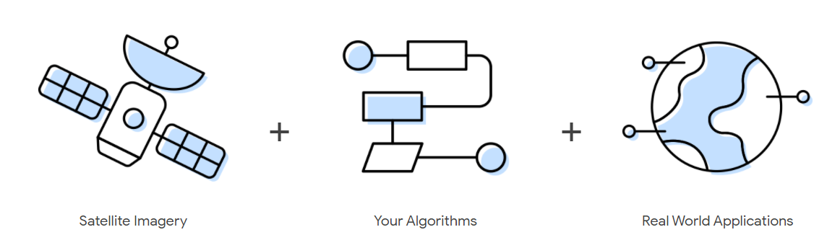
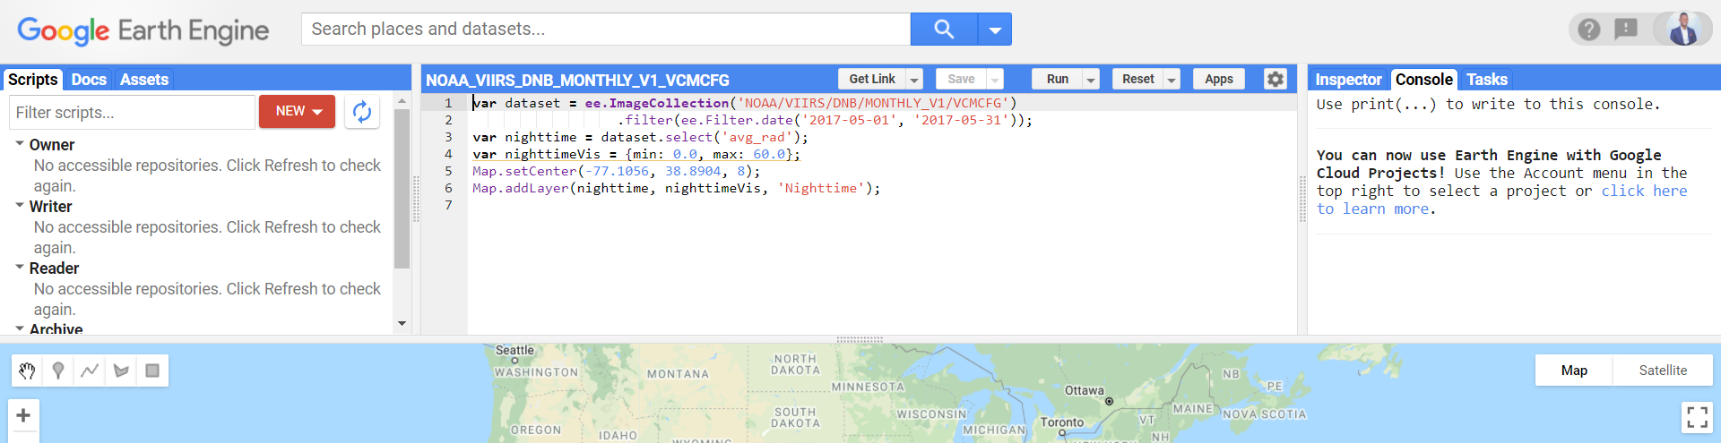
Google Earth Engine (GEE)
Google Earth Engine combines a multi-petabyte catalog of satellite imagery and geospatial datasets with planetary-scale analysis capabilities and makes it available for scientists, researchers, and developers to detect changes, map trends, and quantify differences on the Earth's surface.
This is the platform that the task team used to collect night time images. It has a code editing platform where you can interact with it. More details: https://code.earthengine.google.com/

Slide 5
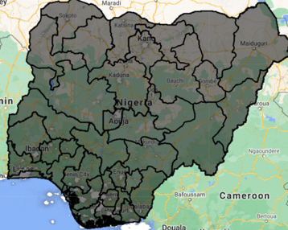
Data Extraction from GEE
The code editor (as shown in the previous slide) is originally written in Javascript. Geemap is a Python package for interactive mapping with Google Earth Engine (GEE). It allows for access to GEE from your local directory. More details about geemap.
For this task, this was the main package used. More details of it being used in extracting the night time images in this task are in the night time task’s google collab notebook.
NIGHT TIME TASK DATA EXTRACTION WORKFLOW
Night time data set (VIIRS) from GEE
LGA | Lat | Long | Avg Night time mean
GEEMAP
Local Governmet Area (LGA) shapefile
Average night time mean for LGAs in Nigeria.
Zonal statistics

Slide 6
Data Extraction Implementation
The night time task team extracted night time averages for the administrative regions in Nigeria. For the purpose of this project, we chose our regions to be the Local government areas in Nigeria (774 in total).
The dataset used for the night time is the VIIRS dataset (VIIRS Nighttime Day/Night Band Composites Version 1 is the name on Google Earth Engine). This contained the year range used in the project. This dataset is a composition of night time image collections covering the every year from 2012 -2021. More details about the dataset here: https://eogdata.mines.edu/products/vnl/
A shapefile is a folder that contains administrative segmentations with its descriptions. For this task, the LGA shapefile was layered on the VIIRS data set and the values extracted using Zonal statistics.
A Zonal statistics operation is one that calculates statistics on cell values of a raster (a value raster) within the zones defined by another dataset (in this case LGAs shapefile). After layering the LGA shapefile on the VIIRS dataset, the mean value of each zone in the raster was calculated. The Geemap package has a class that helped hasten the process.
The population data of each LGA was extracted from World Pop Open Repository and merged with the average night time mean data. Data extracted was handed over to the data gathering team where they added more features to the data, preparing it to be modelled and Visualized.

Slide 7
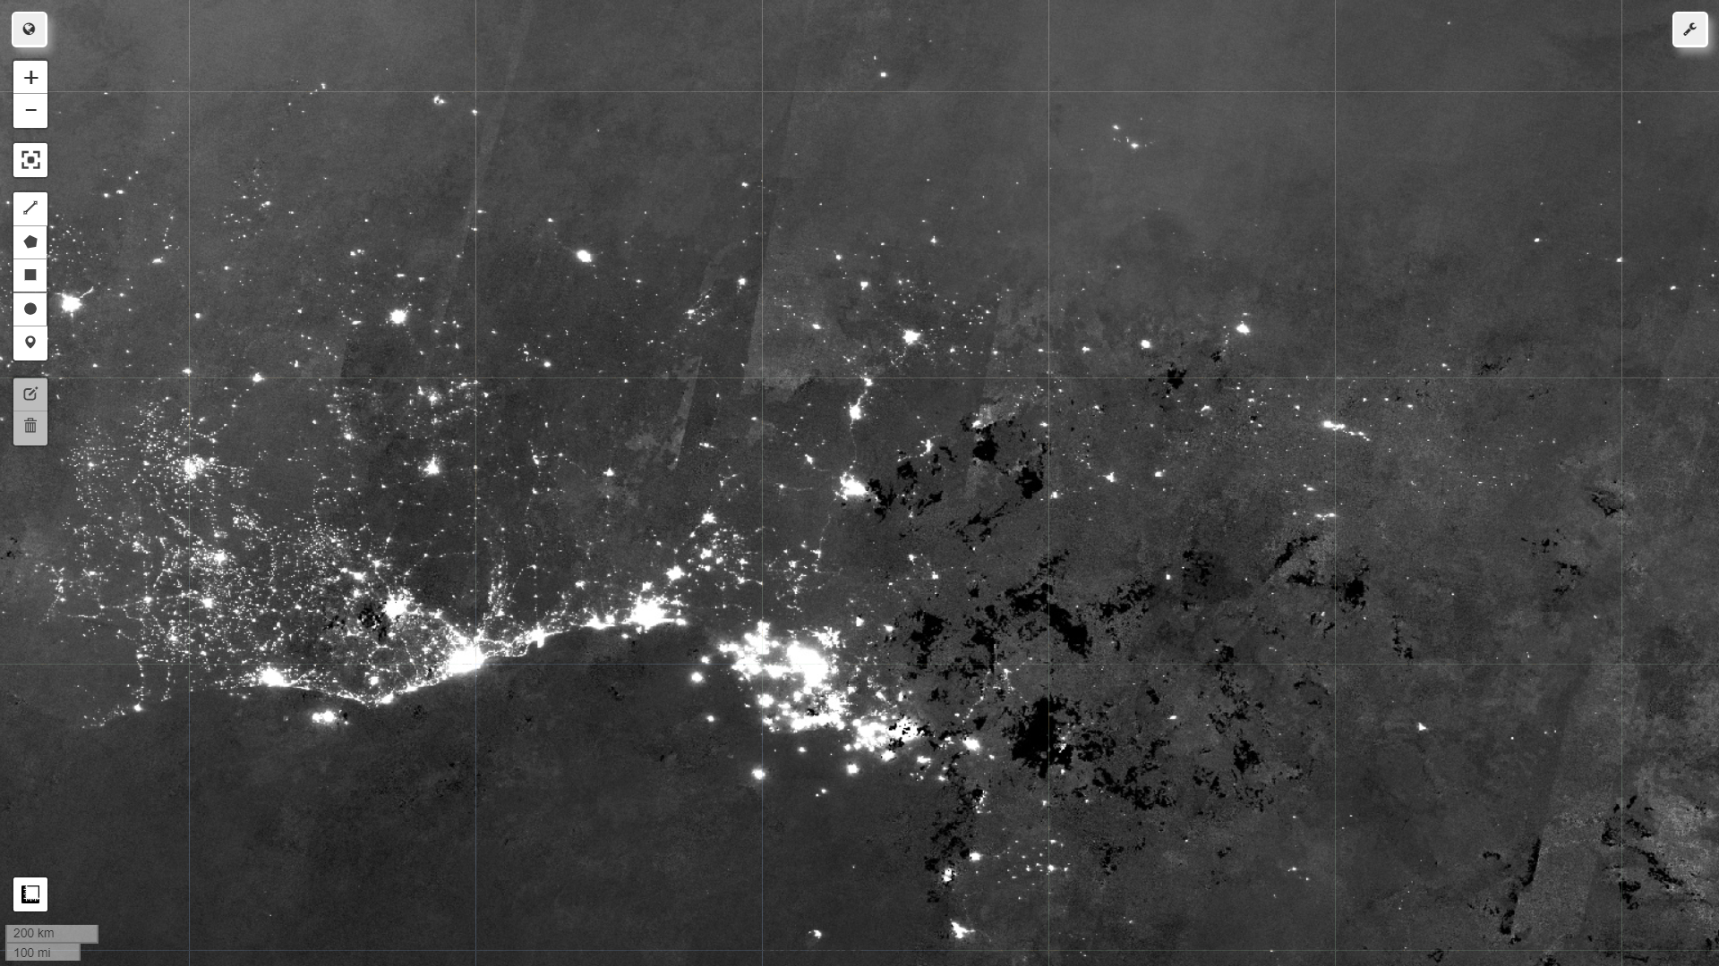
SOME SCREENSHOTS
2020 NIGHT TIME

Slide 8
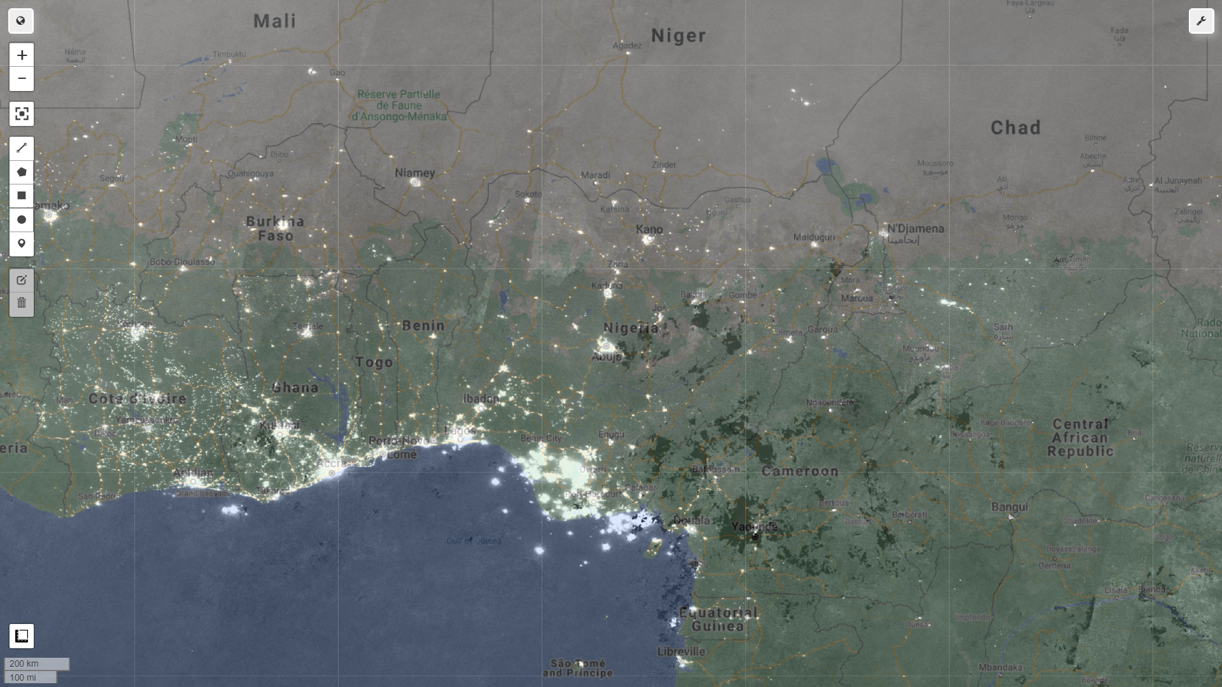
2020 NIGHT TIME

Slide 9
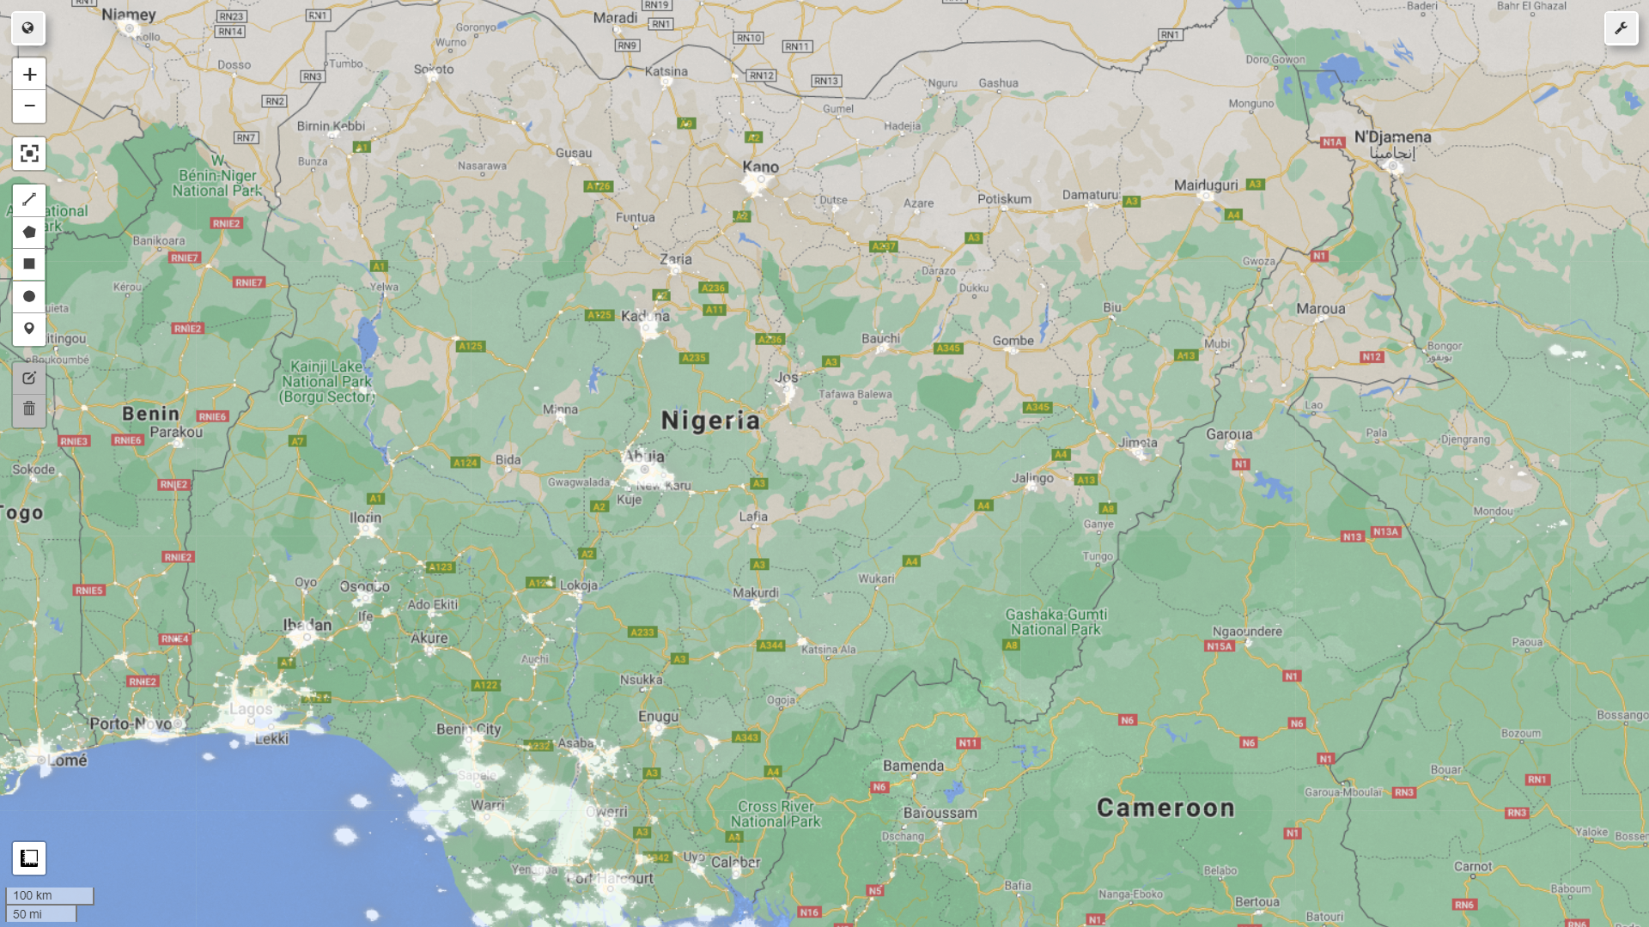
2020 MASKED
NIGHT TIME

Slide 10
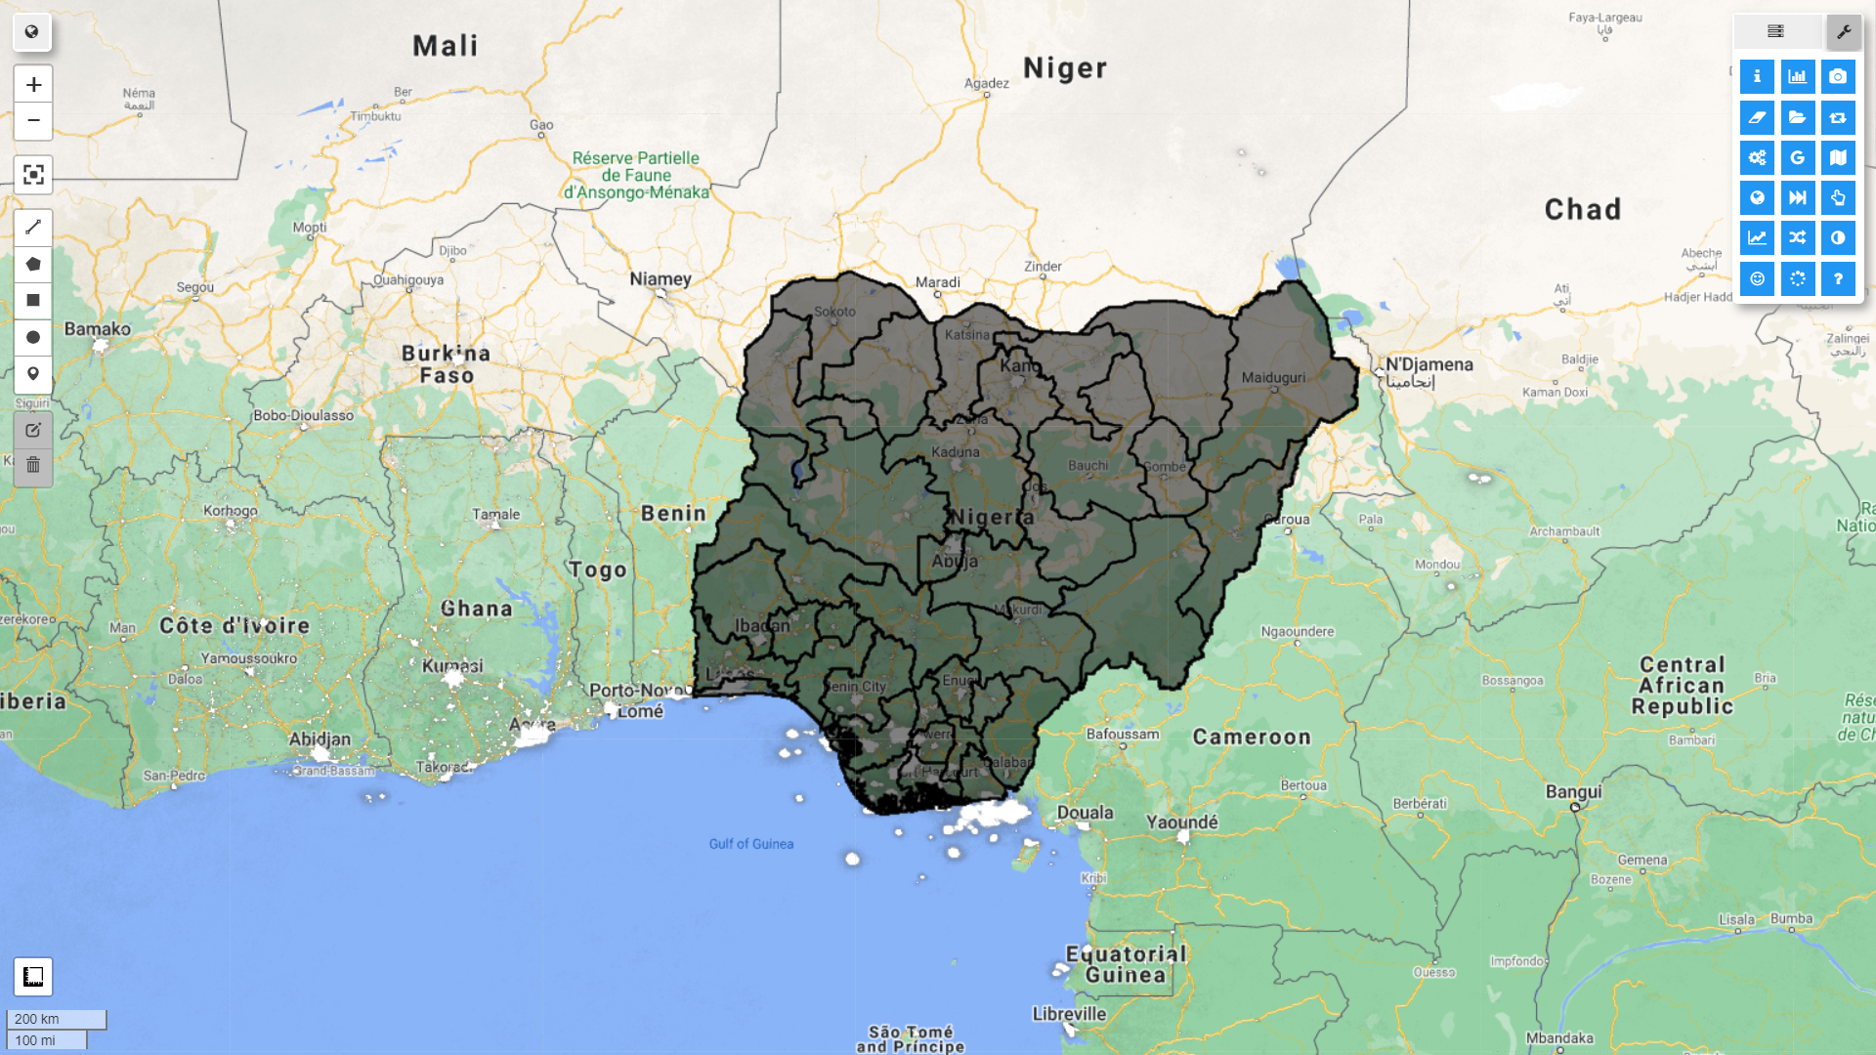
ZONAL STATISTICS

Slide 11
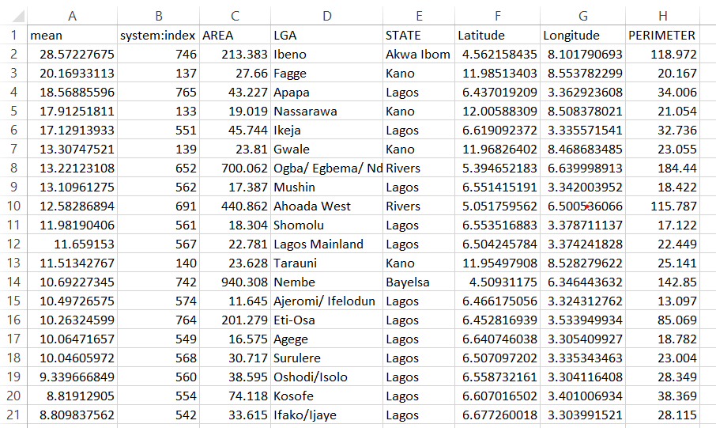
TOP LEADING NIGHT TIME AVERGES (LGA)

Slide 12
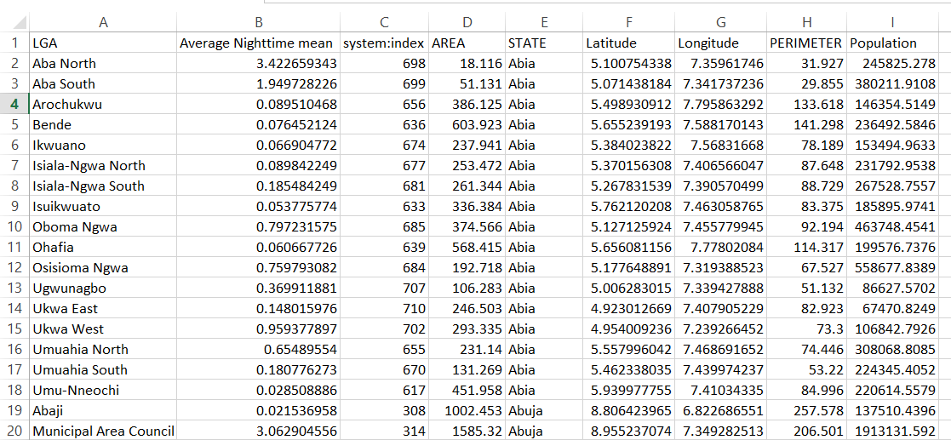
MERGED DATA

Slide 13
RELEVANT LINKS
Link to google collab:
https://colab.research.google.com/drive/1h5cqTSsSZTAV_-zj5334zJ7rkJ3monyM
Link to Data:
https://drive.google.com/drive/u/0/folders/13QOMFOjBEYPumq5M7ycf_ob00m5A5xix
Link to meeting recordings:
https://drive.google.com/drive/u/0/folders/1WHqWkcAX9nlI4Q7D9YjRCU0EMtdcQLpG

Slide 14
Thank you!

